Slide 1
BT201
Biochemical Process Calculations
04/08/2024
Tutorial

Slide 2
Problem 1
The is a dimensionless group defined for a fluid flowing in a pipe as
where D is pipe diameter, v is fluid velocity, ρ is fluid density, and µ is fluid viscosity. When the value
of the Reynolds number is less than about 2100, the flow is laminar that is, the fluid flows in smooth
streamlines. For Reynolds numbers above 2100, the flow is turbulent, characterized by a great deal
of agitation.
Liquid methyl ethyl ketone (MEK) flows through a pipe with an inner diameter of 2.067 inches
at an average velocity of 0.48 ft/s. At the fluid temperature of 20 °C the density of liquid MEK is
0.805 g/cm³ and the viscosity is 0.43 centipoise [1 cP 1.00 x10⁻³ kg/(m s)]. Determine whether the flow is laminar or turbulent. Show your calculations.

Slide 3
Solution: Problem 1
The is a dimensionless group defined for a fluid flowing in a pipe as
where D is pipe diameter, v is fluid velocity, ρ is fluid density, and µ is fluid viscosity. When the value
of the Reynolds number is less than about 2100, the flow is laminar that is, the fluid flows in smooth
streamlines. For Reynolds numbers above 2100, the flow is turbulent, characterized by a great deal
of agitation.
Liquid methyl ethyl ketone (MEK) flows through a pipe with an inner diameter of 2.067 inches
at an average velocity of 0.48 ft/s. At the fluid temperature of 20 °C the density of liquid MEK is
0.805 g/cm³ and the viscosity is 0.43 centipoise [1 cP 1.00 x10⁻³ kg/(m s)]. Determine whether the flow is laminar or turbulent. Show your calculations.
$Re=\frac{Dvρ}{μ}=\frac{2.067 x 2.54 x 0.48 x 12 x 2.54 x 0.805}{0.0043}≈14400$ (turbulent)

Slide 4
Problem 2
A seed crystal of diameter D (mm) is placed in a solution of dissolved salt, and new crystals are observed to nucleate (form) at a constant rate r (crystals/min). Experiments with seed crystals of different sizes show that the rate of nucleation varies with the seed crystal diameter as
a) What are the units of the constants 200 and 10? (Assume the given equation is valid and therefore
dimensionally homogeneous.)
b) Calculate the crystal nucleation rate in crystals/s corresponding to a crystal diameter of 0.050
inch.

Slide 5
Solution: Problem 2
A seed crystal of diameter D (mm) is placed in a solution of dissolved salt, and new crystals are observed to nucleate (form) at a constant rate r (crystals/min). Experiments with seed crystals of different sizes show that the rate of nucleation varies with the seed crystal diameter as
a) What are the units of the constants 200 and 10? (Assume the given equation is valid and therefore
dimensionally homogeneous.)
b) Calculate the crystal nucleation rate in crystals/s corresponding to a crystal diameter of 0.050
inch.
a)
$$r=\frac{200 ∗ 0.05 ∗ 25.4 −10∗{\left(0.05∗25.4\right)}^{2}}{60}=3.96 crystal/s$$
b)

Slide 6
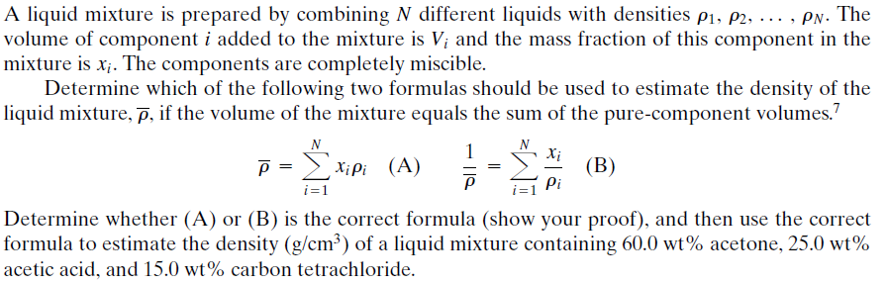
Problem 3

Slide 7
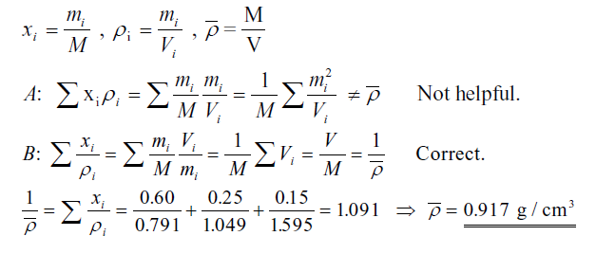
Solution: Problem 3

Slide 8
Problem 4
In the production of a drug having a molecular weight of 192, the exit stream from the reactor containing water and the drug flows at the rate of 10.5 L/min. The drug concentration is 41.2% (wt/wt), and the specific gravity of the solution is 1.024. Calculate the concentration of the drug (in kilograms per liter) in the exit stream, and the flow rate of the drug in kilogram moles per minute.

Slide 9

Solution: Problem 4
In the production of a drug having a molecular weight of 192, the exit stream from the reactor containing water and the drug flows at the rate of 10.5 L/min. The drug concentration is 41.2% (wt/wt %), and the specific gravity of the solution is 1.024. Calculate the concentration of the drug (in kilograms per liter) in the exit stream, and the flow rate of the drug in kilogram moles per minute.
$$Drug concentration =1.024∗0.412=0.422 kg drug /L$$
$$Drug FLOW RATE =10.5∗\frac{0.422}{192}=0.0231 kg mole drug /min$$

